Slide 1


MENTAL
HEALTH

Slide 2


ONE IN FOUR PEOPLE
every year
ONE IN SIX
working age adults

Slide 3
£105bn per year
75% of problems start
before age 18
Men aged 40-49
most prone to suicide
70-75% receive NO TREATMENT

Slide 4
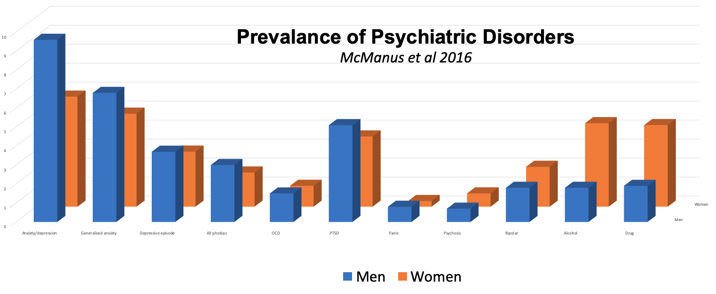

Slide 5


COMMON COMORBIDITIES
Bipolar disorder
Panic disorder
PTSD
Depression
Anxiety
Eating disorder
Personality disorder

