Slide 1
Andrew MacMillan M Ost, PGCME
Alex Corser DO. M Ost
22-01-2020

Slide 2
Why Osteopaths are important to Axial SpA
Axial SpA notoriously difficult to diagnose- 8.5 year delay
Cardinal symptom – inflammatory back pain
Primary healthcare practitioners – may be first contact! (68% chiro 60% Osteo)
Luxury of time – broad examination and case history
Vigilance (ongoing) + clinical reasoning = timely referrals = care pathway
Facilitate engagement with appropriate self management (signposting)
bio-psycho-social management
Collaborating with other AHPs and Medics

Slide 3
Some Stats cos…. Stats are cool
Adults in the UK 220k
1 in 200 of the adult population in the UK have axial SpA (AS). That's twice as many as multiple sclerosis and Parkinson's disease.
Average age
Axial SpA (AS) is a condition that affects young people. Symptoms start late teens to early twenties, with the average age of onset being 24.
Years to diagnosis
The current average delay to diagnosis from when symptoms start is 8.5 years, by which irreversible damage to the spine may have occurred.
Mental health
59% of people with axial SpA report suffering mental health problems compared to 25% of those with mechanical back pain and 5% of the general population

Slide 4
3:1 male to female ratio right? NOPE
Gender and disease spectrum
It used to be thought that three times as many men as women had the disease. This was based on a diagnosis of the disease using x-ray. Men are more likely than women to experience changes to the bones and fusion, and thus they were being picked up using x-ray.
Over time MRI’s were developed which could identify inflammation. Women are more likely than men to experience inflammation rather than fusion.
OR
We don’t screen women effectively and don’t look for it! .

Slide 5
Spectrum of disease

Slide 6
Spectrum of disease
Axial Spondyloarthritis (Axial SpA)
Non-radiographic axial SpA
An MRI shows inflammation of the sacroiliac joints / and or spine An X-ray does not show damage to the joints/spine
Ankylosing spondylitis
An MRI shows inflammation of the sacroiliac joints / and or spine An X-ray shows damage to the joints/spine

Slide 7
Axial Spondiloarthtitis is an umbrella term
The prevalence of nr-axial SpA versus AS is thought to be a ratio of 1:1.
Around 7 in 10 people with non-radiographic axial spondyloarthritis have visible inflammation in the sacroiliac joints or the spine when an MRI of the back is carried out.
Around 3 in 10 may not have any inflammation visible on MRI despite symptoms of back pain. Some may never go on to develop visible inflammation on MRI. The reasons for this are still not well understood but may be due to the sensitivity of MRI.

Slide 8
It’s not your fault! This is badly taught!

Slide 9
AS Myths Busted
It will not burn itself out, that means permanent fusion!
It affects men and women equally
“poker back” and Question mark posture is only visible in end stage disease!
You can not palpate AS or spinal inflammation
AS is a systemic pathology not just back pain or stiffness
Clear blood tests or imaging is not enough to exclude AxSpA (completely or forever)
Regular MRI can not exclude AxSpA, MRI whole spine with STIR is needed
SIJ dysfunctions are highly indicative of AxSpA (not of a sacral torsion)
AS Is cured not cured by : Turmeric ,thinking positively, diet, HVT ( I have tried yoga, I'm still disabled)
Posture isn’t why AS hurts! However we do want to try and keep people upright.

Slide 10
Other Causes of Back Pain
One of the most complex topics in healthcare!
Constant critical evaluation –
a mixed symptom picture? Multiple etiologies? Developing picture over time?
Some key differentials:
Potential ‘red flag’ causes of back pain
Non Specific low back pain = 90%
Psycho-social factors
Other inflammatory causes, RA, Lupus
Repeated acute episodes of multi site pain?
ANA, CRP ESR

Slide 11
Osteopathic Examination
Case history & Context – who are we examining?
Observation
ROM (active and passive):
Spine (especially lumbar), sacroiliac joints, thoracic cage, hips.
Palpation
Bath Indices – our responsibility too!
Critical: Index of suspicion
May have access to imaging and bloods – NASS/IO template referral letter.

Slide 12
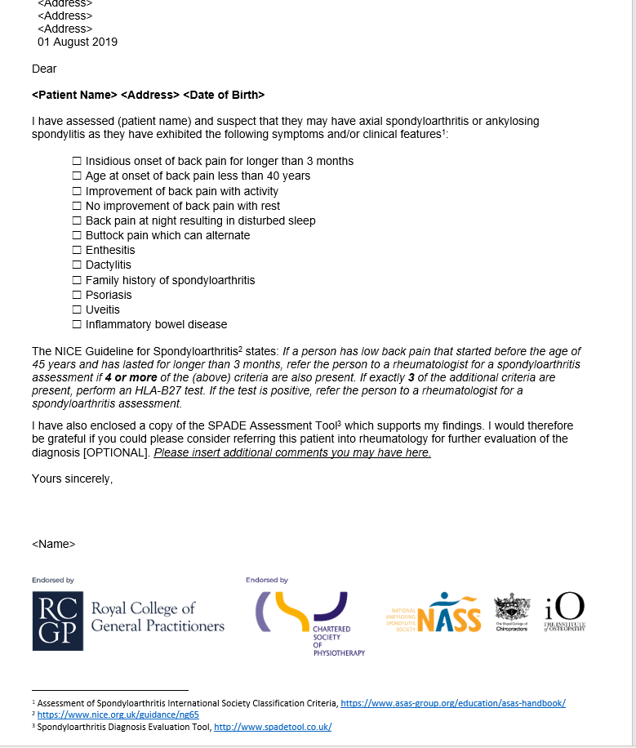
Spade tool and IO referral template letter
WWW.Spadetool.co.uk

Slide 13
Practical
Bath Indices examination
Test Clusters for SIJ

Slide 14
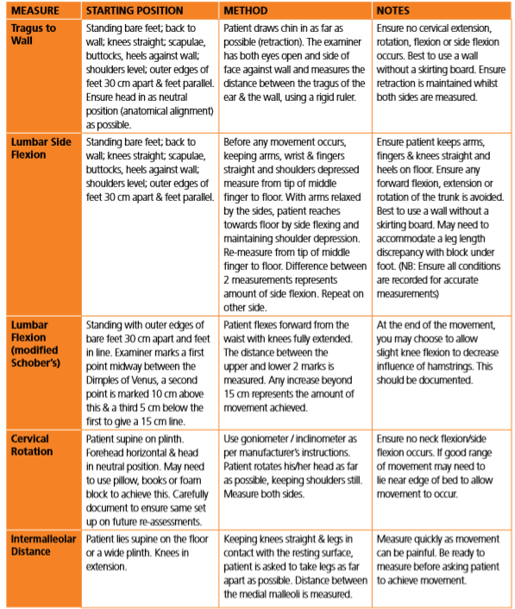
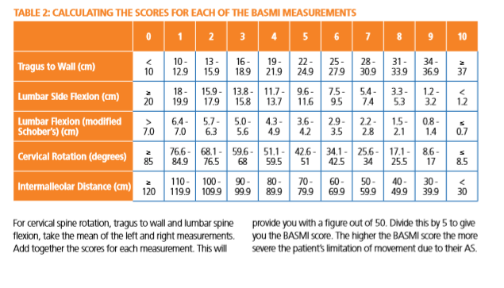
What it actually means

Slide 15
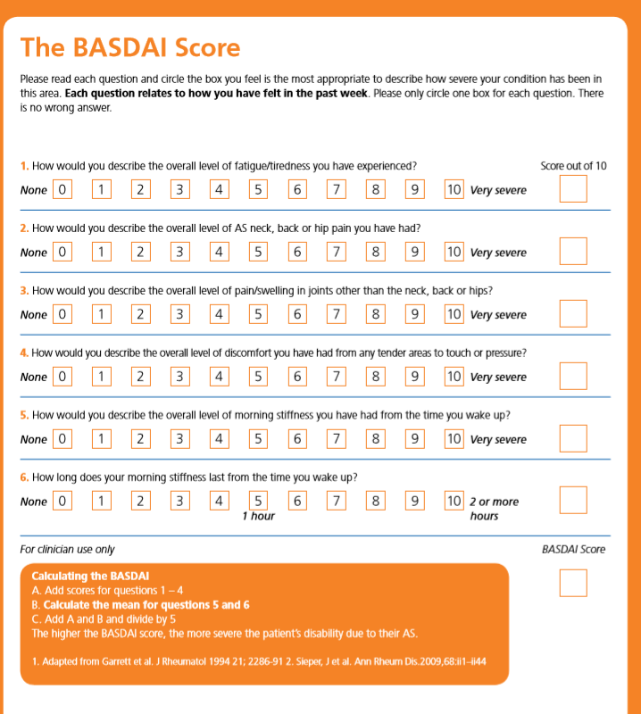
BASDI
The my axspa app is much easier to use and really helps patients communicate disease activity! It also supports research via data collection on medication.

Slide 16
Sacroiliac pain is highly indicative of AxSpA
Test clusters
Common osteopathic tests with little clinical value
STALK
SFT SeFT
Gossip
Illiosacral or sacroillial lesion is it an ascending or descending lesion?
Sacral torsions, physiological or non-physiological
Is it important? Is it autogenic inflammation!
Provocative special tests for diagnosis
These hurt and shouldn’t be routine once diagnosis is confirmed.
Test cluster raises to 90% sensitive and 78% specific for SIJ

Slide 17
Osteopathic ‘treatment’ for Axial SpA
Main aims are to:
Reduce and manage pain
Improve and maintain mobility
Improve and maintain function
Shared decision making, education and empowerment
Patient education/ advice
Hands-on
Treatment
Exercise
prescription

Slide 18
Pain in Axial SpA
Spinal inflammation inc. sacroiliac joints
Enthesitis, Uveitis, Costochondritis
Peripheral – asymmetric oligoarthritis
Vertebral fractures – osteoporosis, hyperkyphosis
Disc and joint degeneration – cycling synovitis
Spinal instability due to atlantoaxial dislocation
Spinal stenosis- may result in neuro- arachnoiditis
Syndesmophytes
Fatiguing of soft tissues – can tissues adapt to structural changes

Slide 19
Achieving Mobility
Primary focus: spine and ribs – creating capacity Peripheral joints relevant:
division of labour
finding ‘space’ in the system where function can be sought
Hands-on treatment:
Joint mobilisation/articulations – rhythmic and fluid – gently into barriers – local and gross motions
Active participation in hands on treatments!
Muscle stretching and MET leading to HEP prescription
Soft tissue work- adaptations of position
Functional and indirect techniques
Caution regarding patients capacity to tolerate TX and manage “ spoons”

Slide 20
Manipulation (HVT)
No spinal manipulation (HVT)
EVER! – yes not even if….
All interventions carry risk
No body of evidence supporting benefit of use in axial SpA/AS
No body of evidence indicating levels of risk- 1-3500 in general population
In absence of evidence in literature – return to the mechanism of action + pathophysiology to derive clinical rationale for choice of intervention
On balance:
Nature of application
Risk of inducing ‘flare up’ – disease activity/quality of life - even short term
Risk of tissue damage
Same effect can be achieved with other techniques

Slide 21
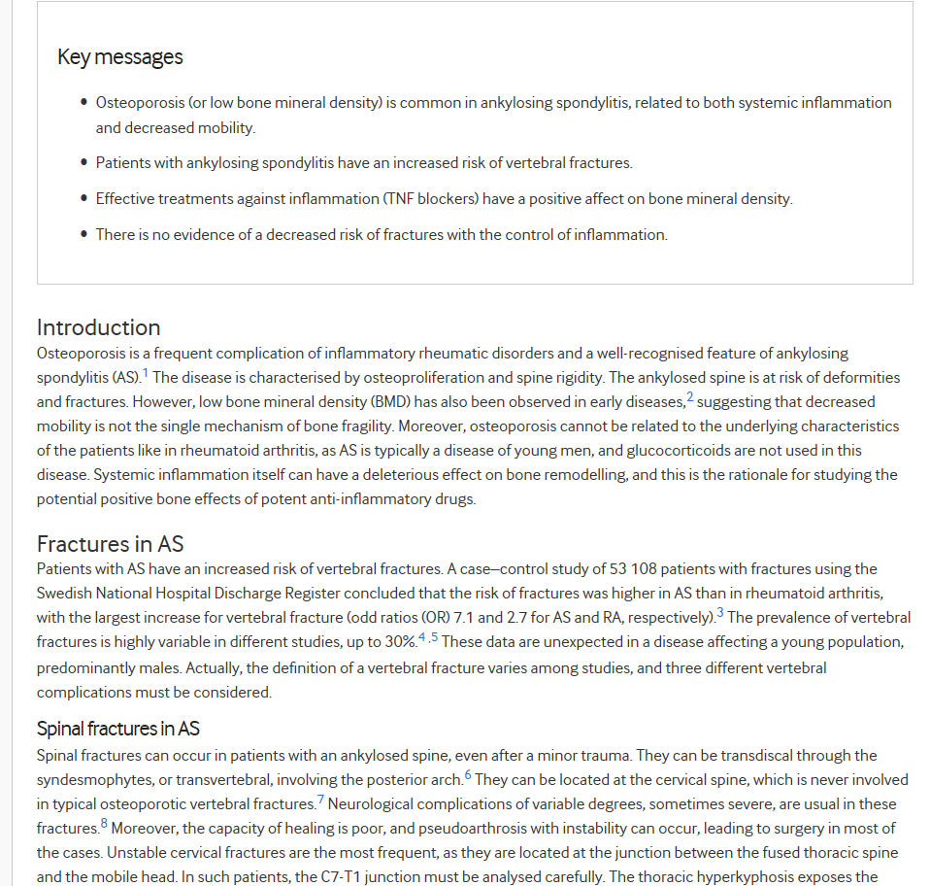
Great anecdote but don’t risk peoples lives

Slide 22
NASS Members experiences of Osteopathy
“I booked to see [chiropractor] and during the consultation I gave him a detailed account about my medical history. It was at this point that he suggested that I may be suffering from AS [axSpA] and actually wrote a letter to my GP recommending that I be blood tested for this. Within 6 months I had the diagnosis and was receiving the appropriate medication.
I went to an osteopath…who kept pulling my neck out and yanking it from one way to the other, and on the third session I couldn’t take it anymore, so I was crying. So, I decided to stop that.”
I feel much better after I see my osteopath, I am less stiff and sleep well. Its really important that we don’t over do it at the session, or it can make me flair.

Slide 23
Restoring Function
MSK
Respiratory
Weight management
Posture
Reducing falls risk- Intrinsic/Extrinsic
Managing pain
Managing patient expectations
Mental health 59% vs 25% general back pain population
Facilitate return to/maintenance of ADLs
Setting goals – motivation!

Slide 24
Considerations for Strengthening & Stretching
Strengthen
Maintain and enhance CVS fitness
Improve flexibility
Enjoyment and compliance
Reassurance and removing barriers to participation
Regressions and progressions
Psychological benefits and social
NASS local groups/ support
“Bad day routines”
Back to action and videos
Example routine
Stretch anterior chain – door frame
Strengthen posterior chain – isometrics
Breathing exercises
Mobility exercises - chair based or gym based.
Childs pose and adaptations..
HYDROTHERAPY – NASS hubs

Slide 25
Pacing & Lifestyle Advice
Advice and Signposting
Appropriate exercise/activity advice (evidence informed)
Healthy eating – vitamin D (bmd issues), balanced diet
Mental Health – IAPT
Smoking cessation
Improve and maintain quality of life:
Work including ergonomics
Home life
Social life
Hobbies/interests/meaningful activities
Managing pain, fatigue & depression:
CBT
Mindfulness techniques
Support groups
Communicating with family

Slide 26
Pharmacological management
Biologics are life changing! --- pros and cons
Better NSAIDS –
Eterocoxib / naproxen
PPI – Omeprazol
CVS risk factors are awful

Slide 27
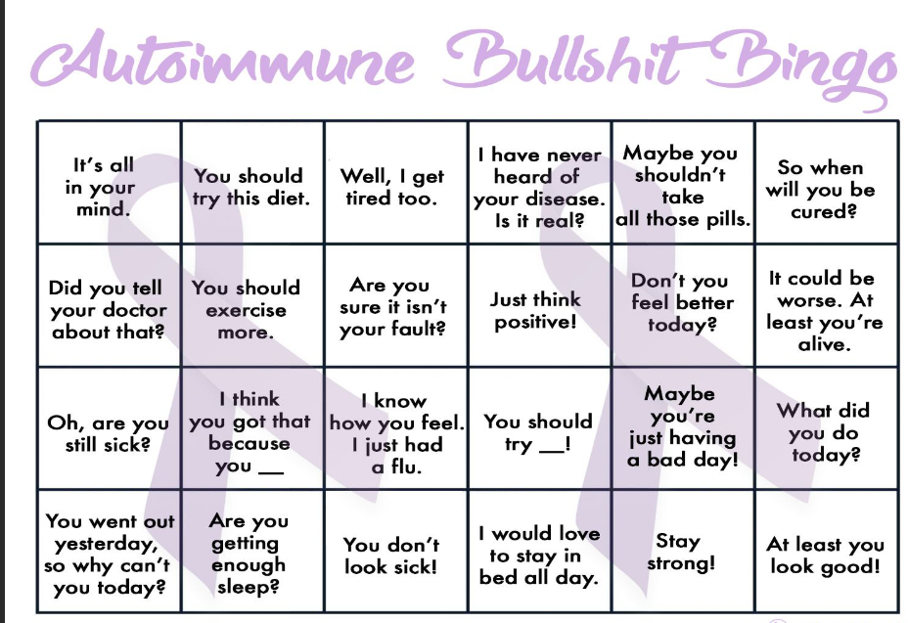
Chronic illness bingo, don’t be part of the problem
.
We must be very considered in how we communicate and the power of our words.
Lets not create feelings of shame and guilt in our patients. We can support encourage and empower.
Cow pat

Slide 28
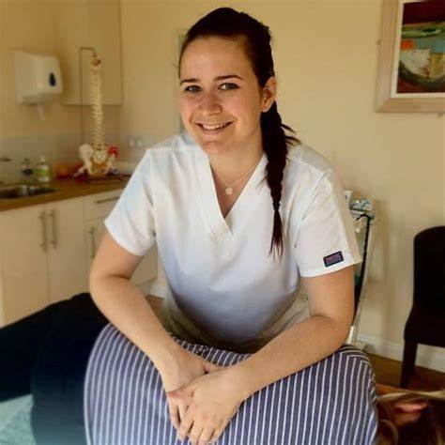
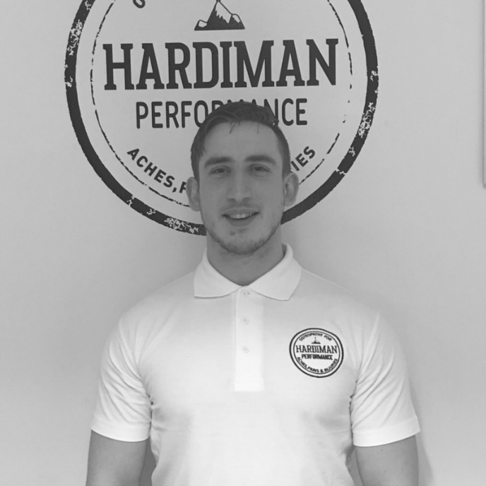
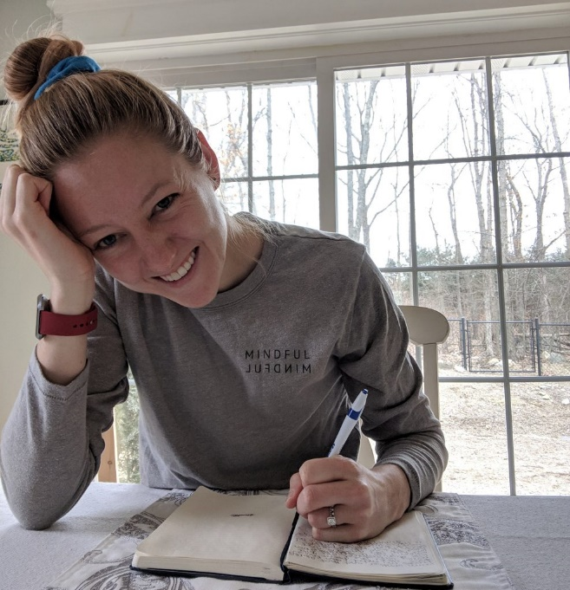
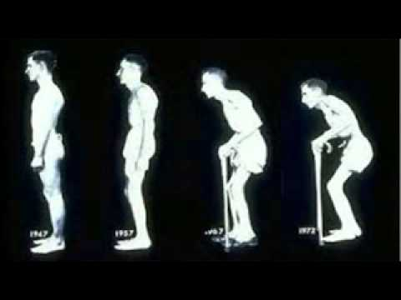
So what does AS look like

Slide 29
References
Macfarlane G et al. Co-Occurrence and Characteristics of Patients With Axial Spondyloarthritis Who Meet Criteria for Fibromyalgia. Arthritis & Rheumatology
2017. Vol 69, No. 11, pp 2144-2150.
McGonagle D. Entheses, enthesitis and enthesopathy. Issue 4 (Topical Reviews Series 6). Autumn 2009.
Kiltz U. Causes of pain in patients with axial spondyloarthritis. Clin Exp Rheumatol 2017; 35 (Suppl. 107): S102-S107
Sveaas S et al. Efficacy of High Intensity Exercise on Disease Activity and Cardiovascular Risk in Active Axial Spondyloarthritis: A Randomized Controlled Pilot Study. PLOS One 2014.
Momeni M et al. Cardiopulmonary Manifestations of Ankylosing Spondylitis. International Journal of Rheumatology 2011.
Regel A, Sepriano A, Baraliakos X, et al. Efficacy and safety of non-pharmacological and non-biological pharmacological treatment: a systematic literature review informing the 2016 update of the ASAS/EULAR recommendations for the management of axial spondyloarthritis. RMD Open 2017; 3.
O’Dwyer T. Behaviour change intervention increases physical activity, spinal mobility and quality of life in adults with ankylosing spondylitis: a randomised trial. Journal of Physiotherapy 2017; 63.
Rudwaleit M et al. Inflammatory back pain in ankylosing spondylitis: A reassessment of the clinical history for application as classification and diagnostic
criteria. Arthritis & Rheumatology 2006. Vol 54, Iss 2, pg 569-578.
Slobodin G, Eshed I. Israel Medical Association Journal 2015. Vol 17.
AStretch and NASS Back in Focus Physiotherapy Modules 1-4.
Accessed: https://nass.co.uk/nass/en/healthcare-professionals/resources-for-health-professionals/health-professional-resources/

