Slide 1
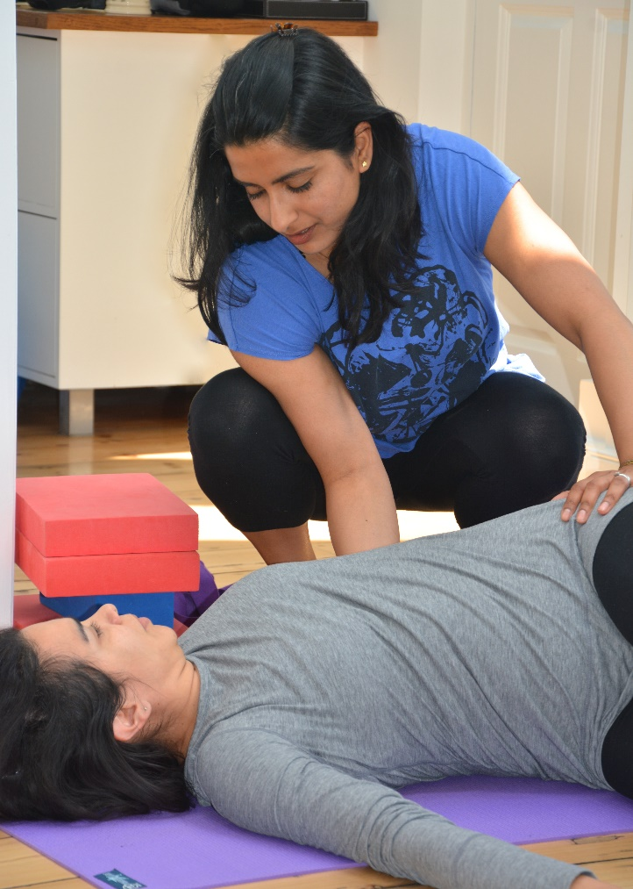
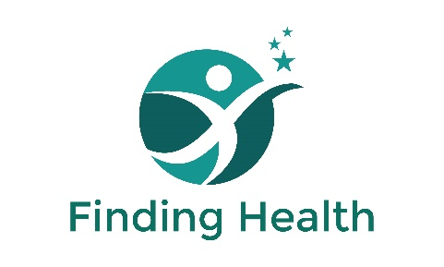
A MATTER OF LIFE & BREATH
Anji Gopal
Osteopath, NHS MSK Clinician, Yoga Teacher and Educator
Notes:
NOTE:
To change the image on this slide, select the picture and delete it. Then click the Pictures icon in the placeholder to insert your own image.

Slide 2
The Colloquy of the Vital Breaths
Once upon a time, Tongue, Eye, Ear, Mind and Breath were arguing about who was the best amongst them.
They appealed to their father, Prajapti, the Lord-of-Creation, for his opinion.
Prajapati said ‘He by whose departure the body seems worse than worst, he is the best of you’.
First Tongue left for a year, and on his return asked ‘How have you been able to live without me?’ The others replied ‘like mute people, not speaking’, yet they were able to see, hear, think and breathe just fine.
Then Eye left for an year. ‘How have you been able to live without me ?’ The others replied ‘Like blind people, not seeing’, yet they were able to talk, hear, think and breathe just fine.
Next Ear left for a year. ‘How have you been able to live without me?’ The others replied ‘Like deaf people, not hearing’, yet they were able to talk, see, think and breathe just fine.
Then Mind left for an year. ‘How have you been able to live without me ?’ The others replied ‘Like children whose mind is not yet formed’, yet they were able to talk, see, hear and breathe just fine.
Finally, as Breath got ready to go, she ripped at the other breaths, ‘as a horse, going to start, might tear up the pegs to which it is tethered’. The others realized immediately that they couldn’t live without Breath.
‘Madam’ they cried, ‘thou art the best among us. Do not depart from us !’
And so, the parable concludes, people don’t call these five the Vital Tongues, the Vital Eyes, the Vital Ears, or the Vital Mind, but the Vital breath (Prana), for the Vital Breath is all these.
Chandogya Upanisad, (c700BCE) translated by Robert Ernest Hume

Slide 3
Topics for today
Intro
How you breathe matters
Yoga & Pranayama
Anatomy of breathing
Practical
References

Slide 4
Does HOW you breathe matter ?
Effects are widespread
Physical
Physiological
Psychological
Conditions

Slide 5
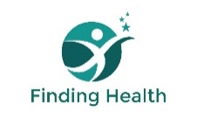
Pranayama
One of the ‘8 limbs’ of Yoga
Prana (Vital Breath) Yama (Control)
Hundreds of techniques
MANY research studies on effects and mechanisms of change
Already used in healthcare:
  meditation / mindfulness / Autogenic Training / Progressive muscle relaxation
Contraindications ?

Slide 6
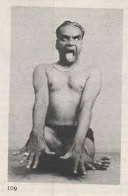
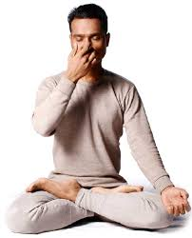
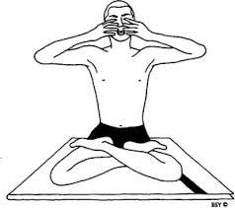
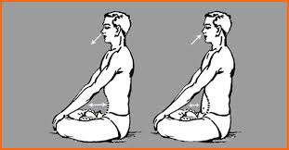

Slide 7
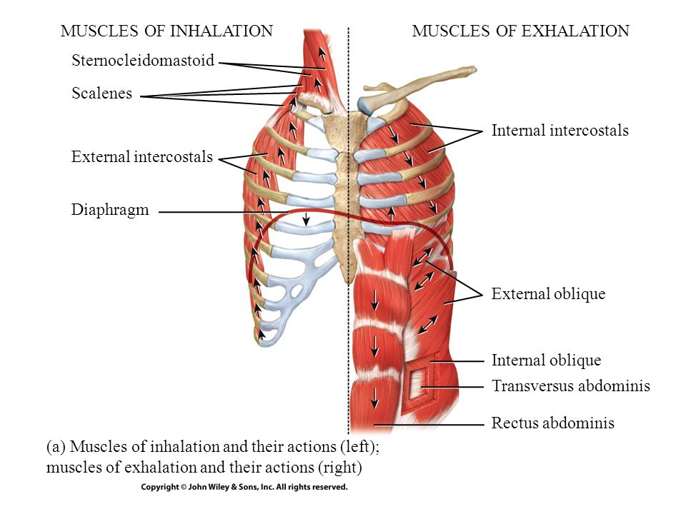
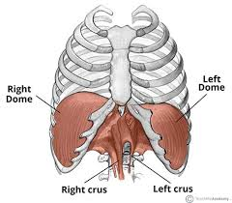
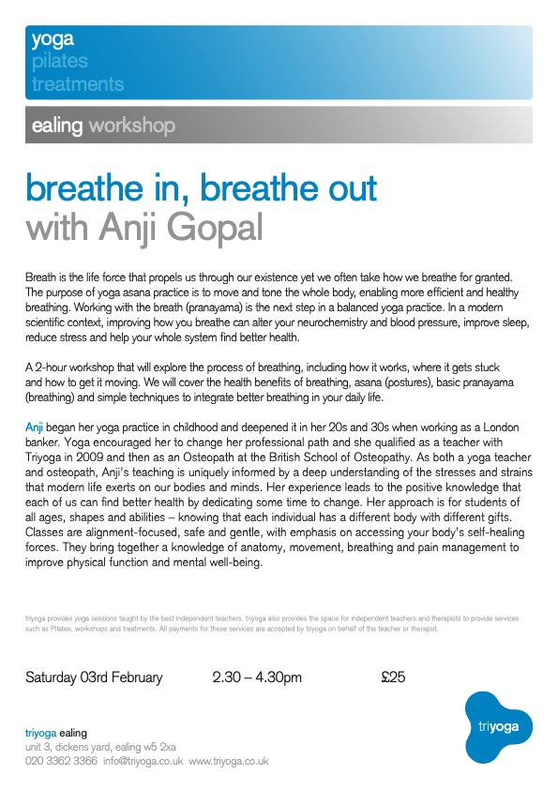

Slide 8
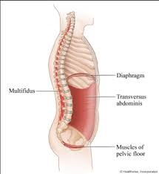
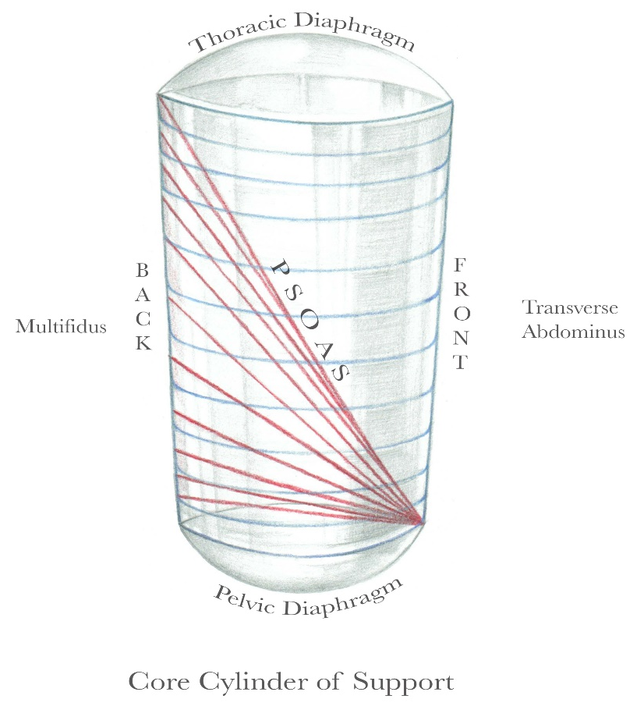
Diaphragm
Multifidus
Transversus
Abdominis
Muscles of
The Pelvic Floor

Slide 9
Practical
Observation & Assessment
  Ribs, diaphragm, psoas etc
  3 section breathing
  Nijmegen Questionnaire ?
(Manual Treatment)
Breathing Techniques
  Position of patient
  Ha breath
  Belly breathing
  Diaphragm breath
  Core breath

Slide 11
References
Doll, (2016) Mindful Attention to Breath Regulates Emotions via Increased Amygdala-Prefrontal Cortex Connectivity. NeuroImage, Vol. 134, pages 305–313
Gard T et al (2014) Potential self-regulatory mechanisms of yoga for psychological health, Frontiers in Human Neuroscience
Gerbarg & Streeter (2017) Iyengar yoga and Coherent Breathing, Journal of Alternative & Complementary Medicine, 23,3 p201-207
Jerath et al. (2015) Self-Regulation of Breathing as a Primary Treatment for Anxiety. Applied Psychophysiology and Biofeedback, Vol. 40, No. 2, pages 107–115
Kaminsky et al. (2017) Effect of Yoga Breathing (Pranayama) on Exercise Tolerance in Patients with Chronic Obstructive Pulmonary Disease: A Randomized, Controlled Trial J Altern Complement Med. 23(9):696-704.
Patel, 1973, 1975 and more. The Effect of Yoga and Biofeedback on the management of Hypertension. The Lancet
Tsai et al.(2015) Efficacy of Paced Breathing for Insomnia: Enhances Vagal Activity and Improves Sleep Quality. Psychophysiology, Vol. 52, No. 3; pages 388–396
FURTHER READING:
The Breathing Book, Donna Farhi,1996, Holt
The Yoga of Breath, Richard Rosen, 2002, Shambala

