Slide 1
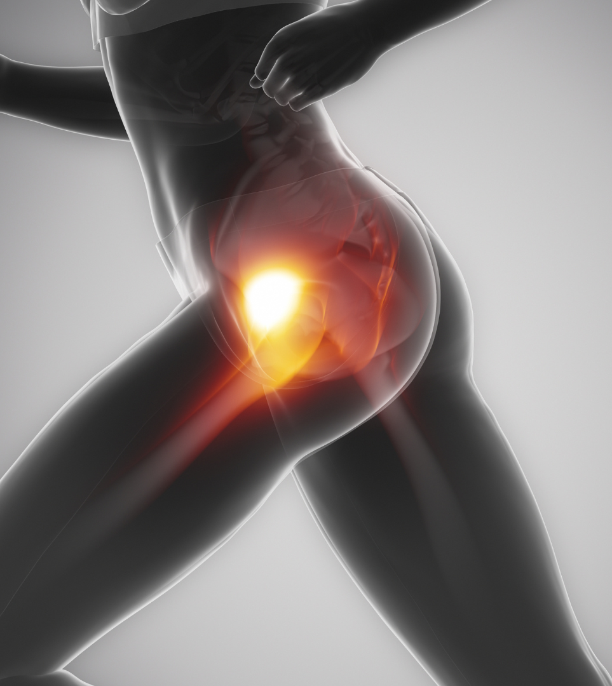
5 Key Factors For A Successful Outcome
In The Conservative Management of Gluteal Tendinopathy
Victoria Smith
Specialist Lower Limb Physiotherapist

Slide 8
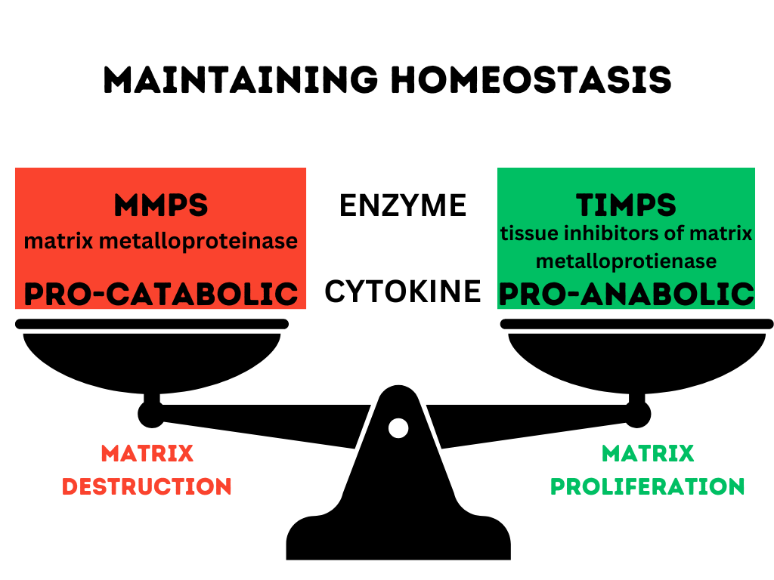

Slide 10
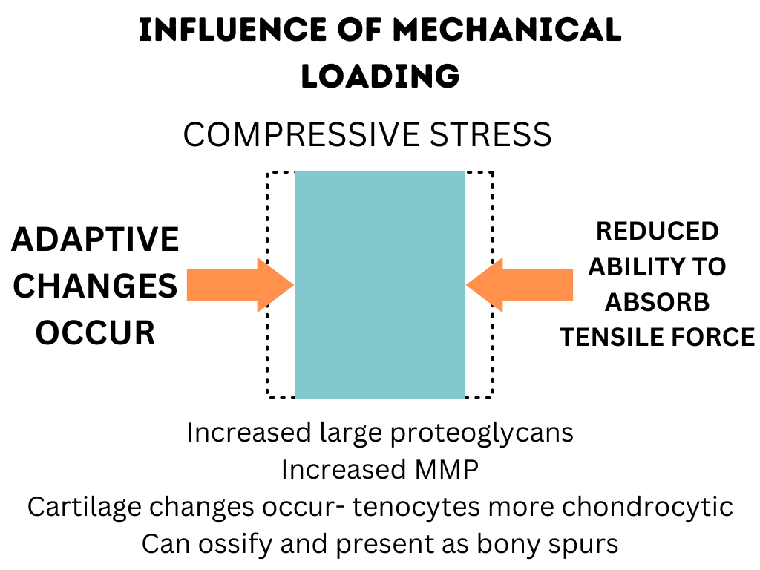

Slide 11
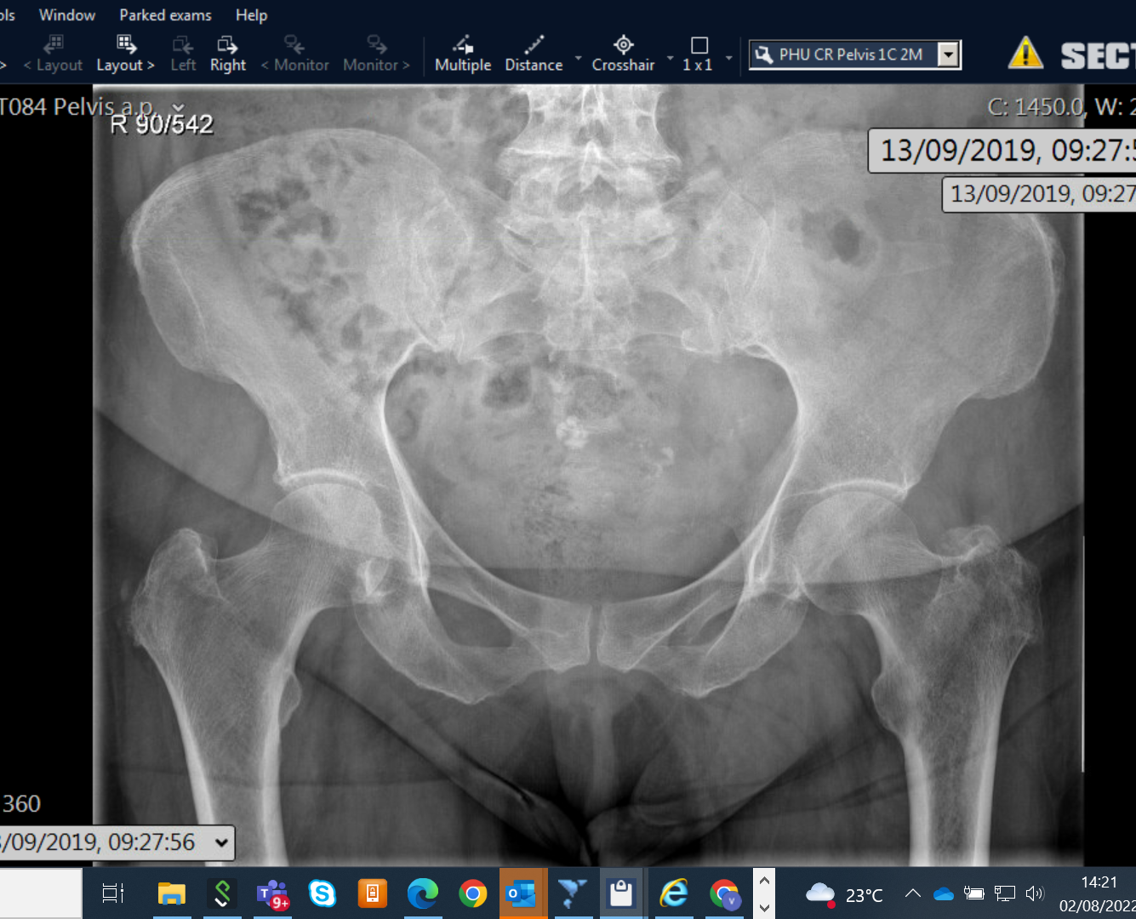

Slide 12
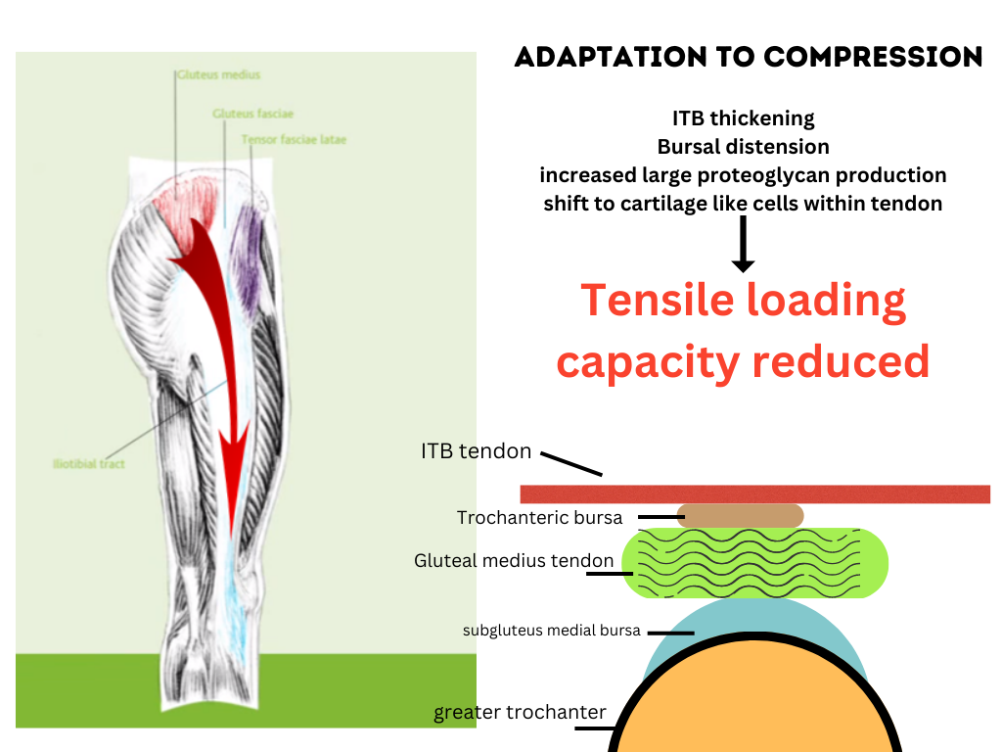

Slide 13
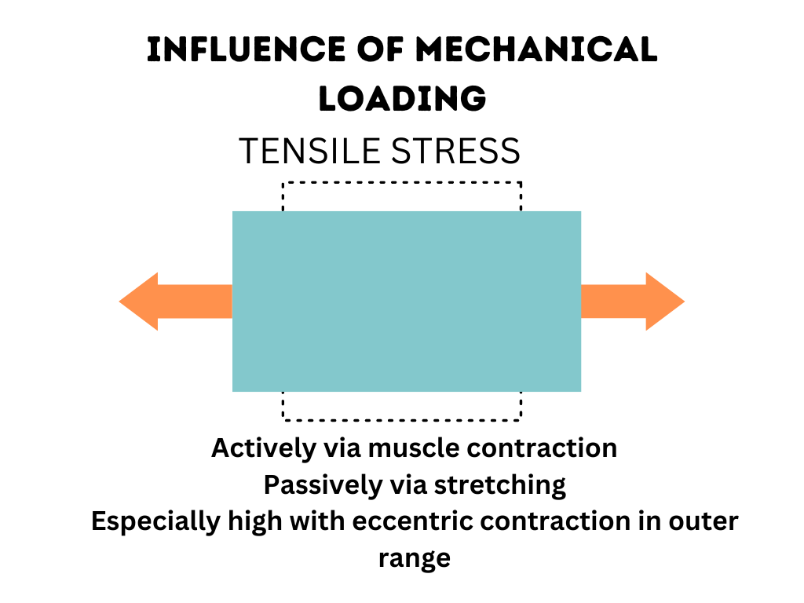

Slide 19
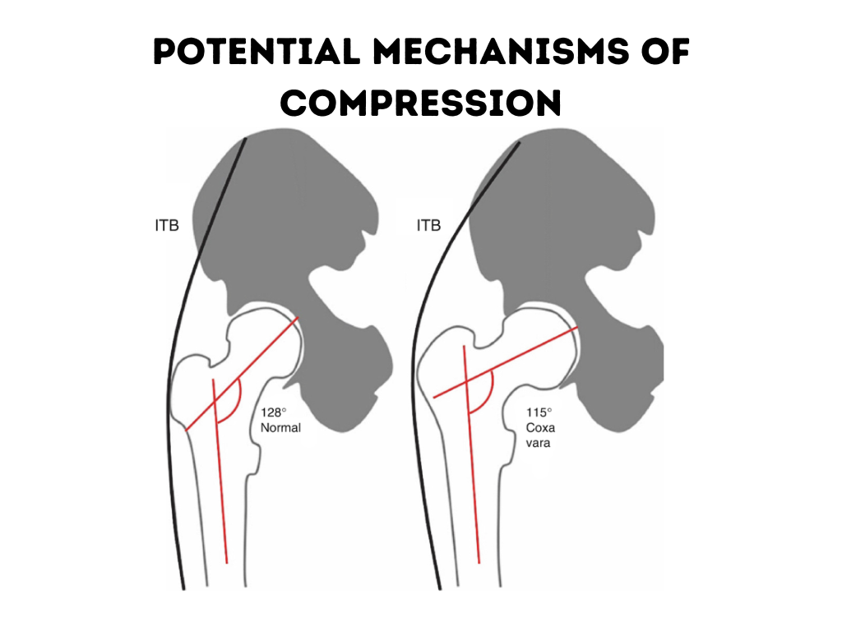

Slide 21
Ensure Correct Diagnosis
Rule out potential DD: lsp, SIJ, Hip intra articular pathology, neural driver
Cluster Testing: ToP GT AND one other positive reproduction of pain from:
Fingertip Sustained SL Stance Test (Lesquesne et al)
De-Rotation Test + Resisted De-Rotation Test
Adduction and Resisted Adduction Test
FABER (not as useful as active tests)
Imaging as last resort if unclear :MRI modality of choice

Slide 27
Load Management
Reduce Compression: minimise positions/ activities involving sustained or repetitive compressive forces (i.e hip hang/sitting legs crossed/sit to stand with excessive hip add)
Advice on alternative positions/ postures: sleeping positions/ eggshell mattress
Control high tensile loads- especially rapid increases /activities with added compression-re-educate movement pattern/ use aid
Educate around potentially aggravating activities/ careful titration of exercise volume
Maintain some form of recreational/ sporting activity- guidance on minimising most provocative element- unique to previous activity level

