Slide 1
THE HAMSTRING INSIGHT

Slide 2
Why Hamstring Strain?
1996 Olympics
55% legs
51% hamstrings
(Nannini et al 1997)
FA Medical Centre
2 year audit
12.5% all injuries
7% recur
(Hodson et al 2000)
Why is the hamstring vulnerable…?

Slide 3
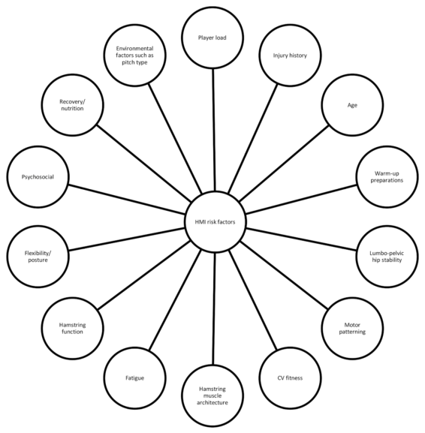
Buckthorpe et al 2018. Recommendations for hamstring injury prevention in elite football: translating research into practice Br J Sports Med

Slide 4
Mechanisms of Bipedalism
Dinosaurs, kangeroos & birds all use a passive counter-balancing tail.
Birds also shifted pelvic viscera posteriorly. (Ahlberg 2000)

Slide 5
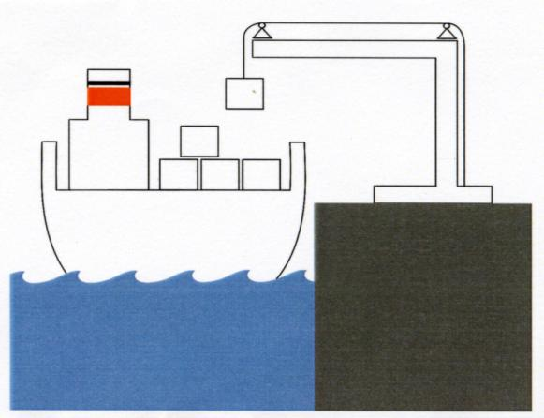
Mechanisms of Bipedalism
Hominid evolution opted for an active myofascial system to achieve bipedalism.

Slide 6
Muscle injury continuum
Microtrauma
Macrotrauma
Eccentric Overload
D.O.M.S.
Grade I
Strain
Further Loading
Grade II
Strain
Further Loading

Slide 7
Hamstrings’ role in sports injury
Cutting and planting sports are associated with high levels of
Hamstring strain
ACL injury
Meniscal Injury
Ankle Sprain
Hodson:
500 rotations /
Game (40 degrees)

Slide 9
Global stability (outer unit)

Slide 11
The abdominal aponeurosis
Linea alba
IO
EO

Slide 12
Deep Lamina Posterior Layer Thoracolumbar Fascia
ST ligament & fascial sweep toward…
Multifidus
Line of force toward…
Internal Oblique
Gluteus Medius
Iliac crest, Spinous Process
Sacrum

Slide 13
Deep P-A sling (Wallden 2000)

Slide 14
Visceral fulcrum theory (Wallden 2000)
Core stability: TVA
“Visceral cylinder” theory
ATP-PC system
Muscle chains / Anatomy trains / Muscle slings / Contractile fields theories

